Slide 1
Smart Green House
A project for advanced embedded lab
Team: GORGONZOLA
Younsuk Choi
Yigitcan Aydin
Syed Rafsan Ishtiaque
Muhammad Rohail Usman

Slide 2
Motivation
For Green House, the control of Light and Temperature is very important
Smart Green House: Employs a distributed system in which microprocessors and sensors are communicating through WSN techniques
Our smart agriculture specifies the environmental constraints of a greenhouse where we can manage our crop by handling data from temperature sensors and light sensors

Slide 3
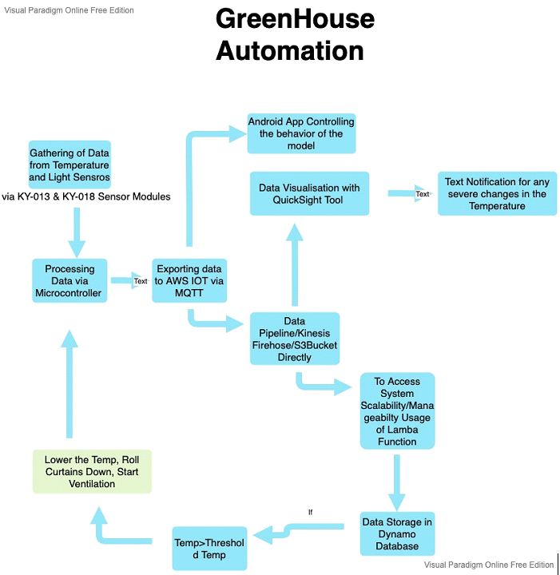
Concept Description

Slide 4
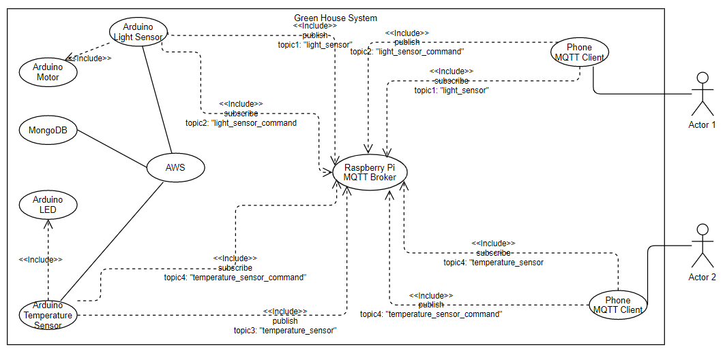
Use Case

Slide 5
Used HW/ SW
Arduino
Mosquitto Broker
Network Analyzer
Mobile SSH
VNC Viewer
MQTT Dashboard
Arduino Uno Wifi Rev 2
Raspberry Pi 3
KY-013 Temperature sensor (NTC)
KY-018 Photo-resistor
KY-053 Analog-Digital Converter
RB 35 Motor
LED
DHT (used instead of KY-013)

Slide 6
Technical Implementation
Code Demonstrated in Arduino IDE

Slide 7
Demonstration (Video)

Slide 8
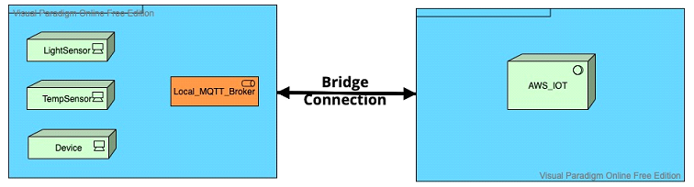
AWS Bridge Connection

